Slide 1
BEFUTURE
Acceleration Programme
Key facts about the Pool of Mentors

Slide 2
Agenda
The BEFuture project
The BEFuture Acceleration Programme
Benefits of becoming a BEFuture mentor
Tasks and duties of BEFuture mentors
Admission criteria
Application process
Steps after selection
Timeline for mentors and projects
Contact and more information

Slide 3


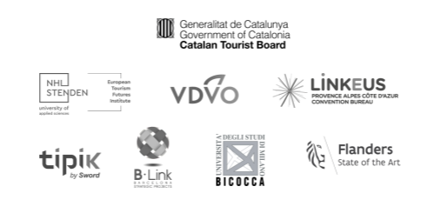

1. What is the BEFuture project all about?
BE Future is dedicated to driving positive change in the Meetings, Incentives, Conferences and Exhibitions (MICE) sector across Europe.
Our mission is to transform the industry into a regenerative, resilient, and responsible powerhouse.
Partners:
Budget:
4,1 M EUR
Calendar:
September 2023 – March 2026

Slide 4
1. What is the BEFuture project all about?
Aligned with European Tourism Transition Pathway and Sustainable Development Goals, we prioritise sustainability, inclusivity and lasting impacts.
Objectives:
Creating a new business model that strengthens sustainability, digitalisation and resilience.
Co-designing solutions with the entire business events ecosystem to make a positive and enduring impact.

Slide 5
1. What is the BEFuture project all about?
Initiatives:
Stakeholders’ network
Compilation of Best Practices on the Business Events Industry
BEFuture Acceleration Programme
New Scenarios and Business Models for the Future of Business Events
BEFuture White Paper (upcoming)

Slide 6





2. BEFuture Acceleration Programme
More than 80 innovative projects in 6 European countries
Ranging from 20.000 to 30.000 EUR
Trainings
Access to industry experts and networking opportunities
Visibility and recognition
(IBTM 2025)
Access to expertise (Mentors)

Slide 7
Who can participate?
Type of participants
SMEs as individual applicants or partnerships containing up to 4 entities (at least 1 SME, and at least 70% of the budget for SMEs).
Partnerships can include also public/private entities, providing that they essential to the project implementation.
Geographical eligibility
Applicants must be registered in one of the eligible countries: France, Germany, the Netherlands, Italy, Catalonia (Spain) or Flanders (Belgium).
NACE code
The Applicants’ activities need to be registered under specific NACE codes, relevant to the Business Events industry.

Slide 8
What are we looking for?
Technology-Based Projects:
Projects that utilize new or significantly improved technologies to enhance efficiency and effectiveness in the business events industry.
Sustainable Solutions:
Projects that promote environmental sustainability, such as the use of renewable energy, biodegradable materials, or strategies to reduce the carbon footprint.
Resilience Improvement:
Projects that increase the industry's capacity to adapt and recover from challenges, such as economic changes or health emergencies.
Promotion of Inclusivity:
Projects that ensure equitable access and participation in business events, both from the perspective of attendees and organizers, including technologies to improve accessibility.

Slide 9
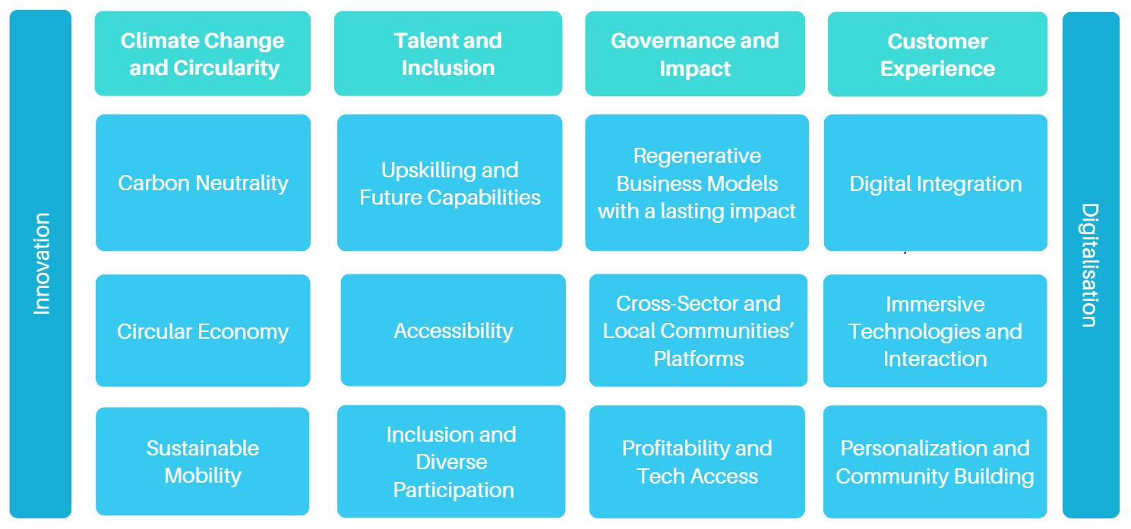
Scope of the innovative projects:
Source: New Scenarios and Business Models for the Future of Business Events

Slide 10
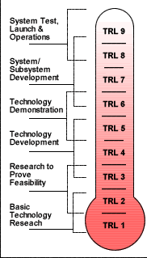

What are we looking for?
Innovative Projects must be at Technology Readiness Levels (TRL) 4, 5, or 6, indicating that they are in the concept validation or development phases, suitable for rapid completion within the program's timeframe.
  TRLs definition and assessment tool: https://horizoneuropencpportal.eu/sites/default/files/2022-12/trl-assessment-tool-guide-final.pdf

Slide 11

What are we looking for?
More details in the Guidelines of the Call for Projects and Get funding page
Informative sessions
Global Innovation Forum, 18th November in Barcelona
Informative session, 27th November, Online
Local Q&A sessions

Slide 12
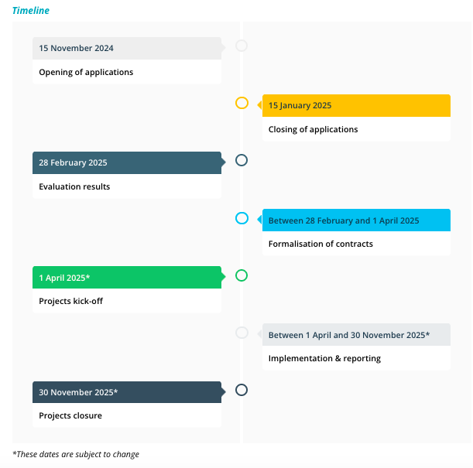

Calendar
Projects will last 8 months
Tentatively:
From 1st April 2025 to 30th November 2025

Slide 13
3. What are the benefits of becoming a BEFuture mentor?
BEFuture projects will be supported by mentors and industry experts to enhance projects’ results, overcome challenges and accelerate their development towards market readiness. A specific Call for Mentors has been launched.
Why should you apply to become a BEFuture mentor?
Paid mentoring opportunity
Collaboration with creative minds and innovative organisations
Shape the future of the Business Events sector
Visibility in the BEFuture Platform and overall ecosystem

Slide 14
4. What do we expect from a BEFuture mentor?
An agreement with the project Applicant will be signed, stipulating minimum 20 hours of mentorship, value, duration, payment conditions...
Support
Oversee project specific tasks to facilitate the achievement of project objectives under the BEFuture Acceleration Programme
Opportunities
Encourage the project to take advantage of support services available through BEFuture and other initiatives
Reporting
Assistance to the mid-term and final interviews
Guidance in the Final Report preparation
Duties

Slide 15



5. Who can be a BEFuture mentor?
A minimum 3 years of experience supporting SMEs and other stakeholders within the business events industry and related sectors, through innovation processes.
Being a resident of the European Economic Area (= EU countries + Iceland, Norway, Lichtenstein) or Switzerland.
Appropriate working knowledge of English (minimum B1). Knowledge of other languages of the project is an asset.

Slide 16
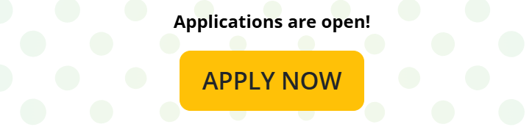
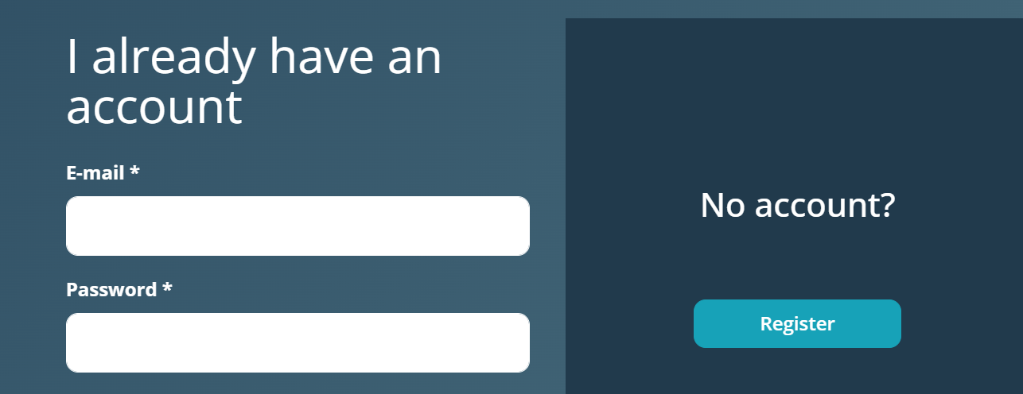
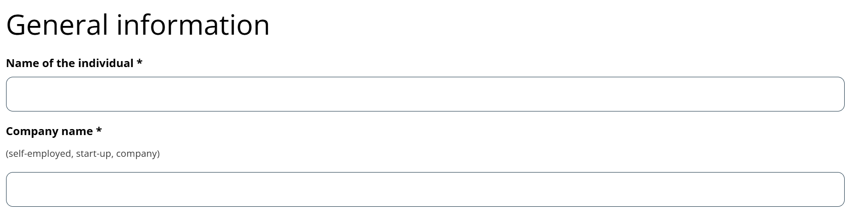
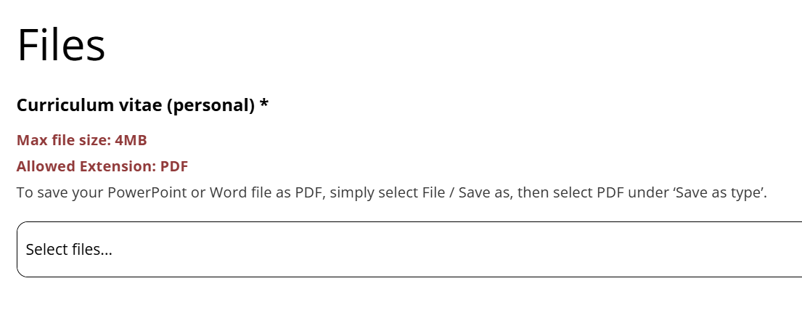
6. How does the application process work?
1
Go to https://www.be-future.eu/acceleration-programme/call-for-mentors/#profile
2
Enter or register to the BEFuture Platform and go to
My Mentor Application
3
Fill in the necessary information and upload the required documents

Slide 17
7. What happens if I succeed?
Your profile will be part of the BEFuture Pool of Mentors and showcased in the BEFuture Marketplace.
Each selected innovative project will choose a mentor from the Pool, before 15th of May.
A collaboration agreement is signed, and the mentors’ tasks start, lasting until the end of the project.
Work location –remote or in-person- to be agreed between mentor and projects

Slide 18
8. Timeline for mentors and projects
Call for mentors open
Last day to sign a Contractual Agreement with a Project
Mentors
Access to the Pool will be notified to mentors within 30 days from the Application
Mentoring implementation
October 2024
15th May 2025
15th Nov 2024
15th Jan 2025
28th Feb 2025
1st Apr 2025
30th Nov 2025
Project implementation -8 months-
Projects
Call for projects open
Call for projects closed
Evaluation results
Projects start
Projects end

Slide 19


9. Contact and more information
Please, find more information in the BEFuture Pool of Mentors webpage
The most Frequently Asked Questions are answered here
For inquiries or more information: call-inquiries@befuture.eu (Marta Rojas)

Slide 20

Time for questions

